Slide 1

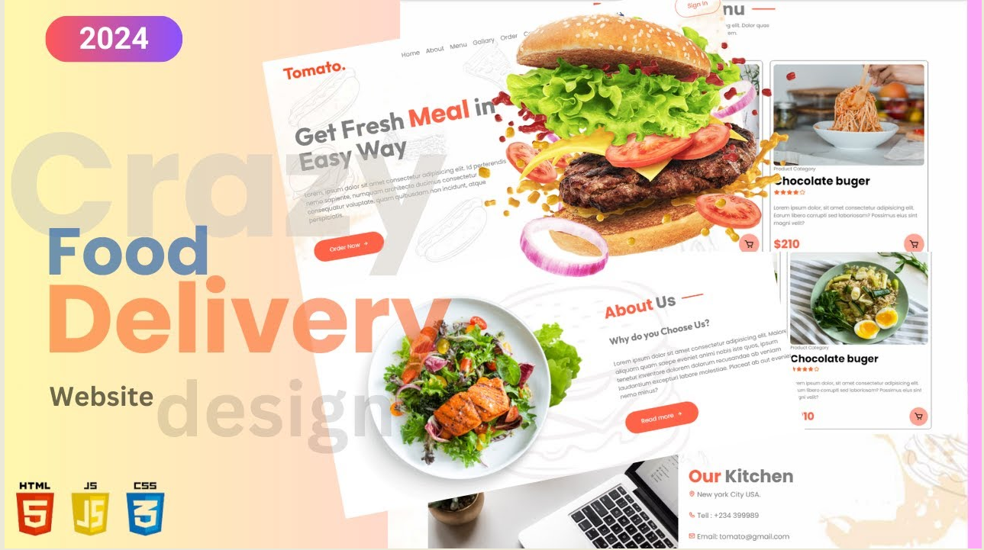

ONLINE FOOD DELIVERY WEBSITE

Slide 2



FoodieExpress
Presentation on
Online Food Delivery website
Submitted to:- Submitted by:-
Mrs. Neeru Jain Anjali Kumari
Komal

Slide 3
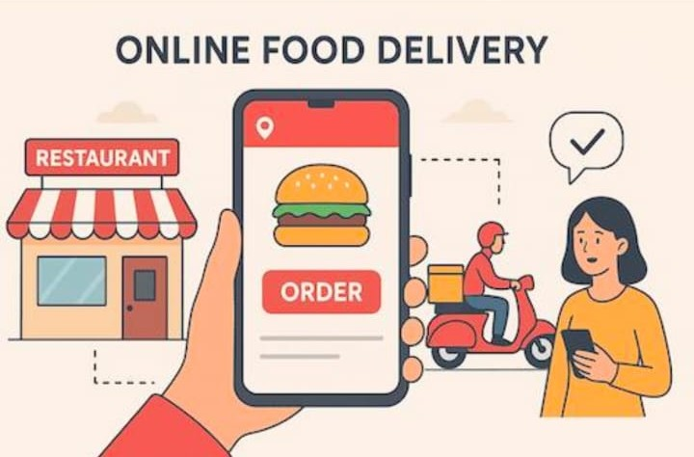
INTRODUCTION
“FoodieExpress is an online food delivery website. We created this website using HTML, CSS and JavaScript. It allows users to view different food items with their prices, search for food, add food items to the cart and place an order. The website has different pages like Home, Login, Sign Up, Menu, Cart, Checkout, Order Placed and Admin Panel. Our main aim is to make food ordering easy, simple and convenient for users.”

Slide 4

OBJECTIVES
To provide an easy online food ordering system.
To allow users to register and log in.
To display food items with price and details.
To allow users to add , update and remove cart items.
To provide a simple checkout and order placement process.
To provide and admin panel for the project.

Slide 5
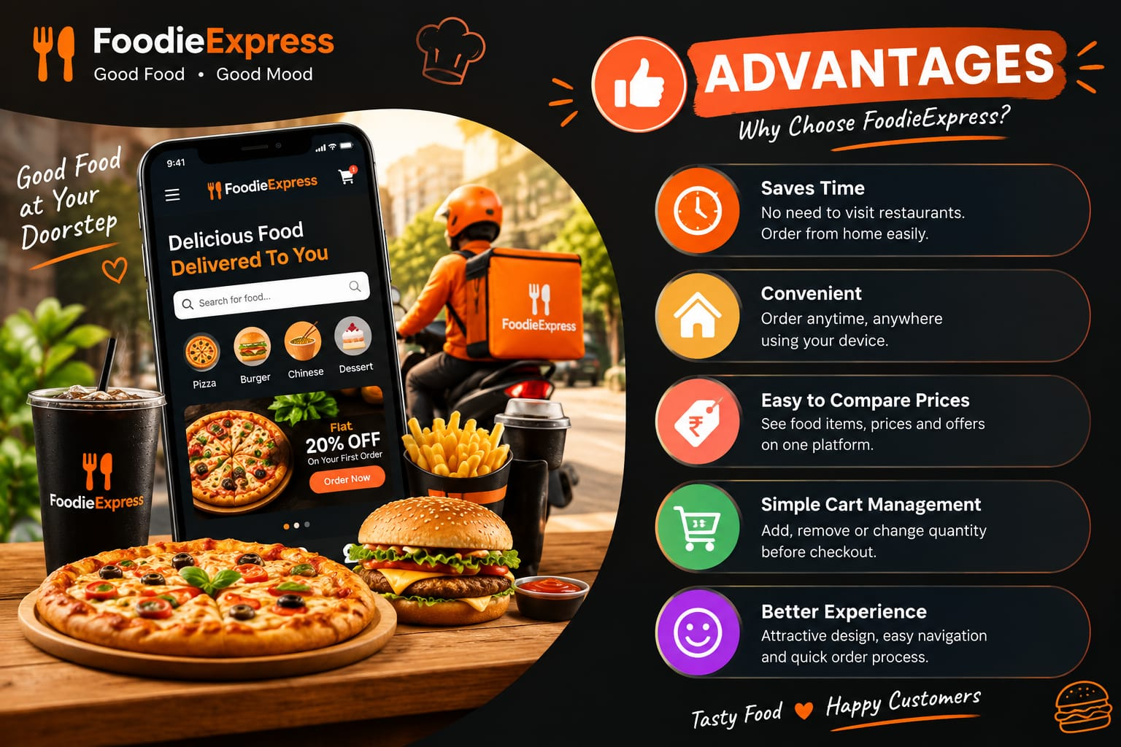
ADVANTAGES
Easy Ordering :- User can select food and place and order easily.
Saves Time:- Users do not need to visit the restaurant first .
Easy Cart:- Quantity can be increased , decreased or removed.
Food Details:- Names, Prices and Categories are clearly shown.
Simple Interface:- The website is easy to understand.
Admin Panel:- Provides a separate area for basic management.

Slide 6
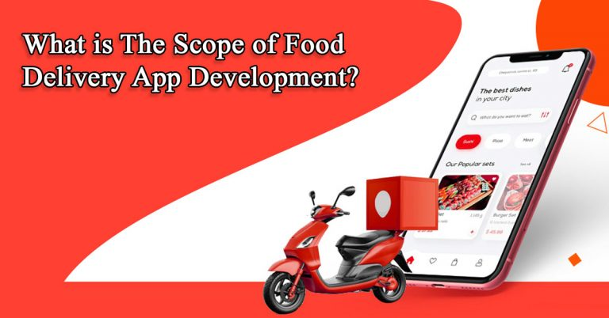
SCOPE
Customers can browser different food items.
Customers can search and select food by category .
The cart stores selected items and calculates the total.
Checkout collects customer and delivery details.
Order confirmation can be shown after placing and order.

Slide 7
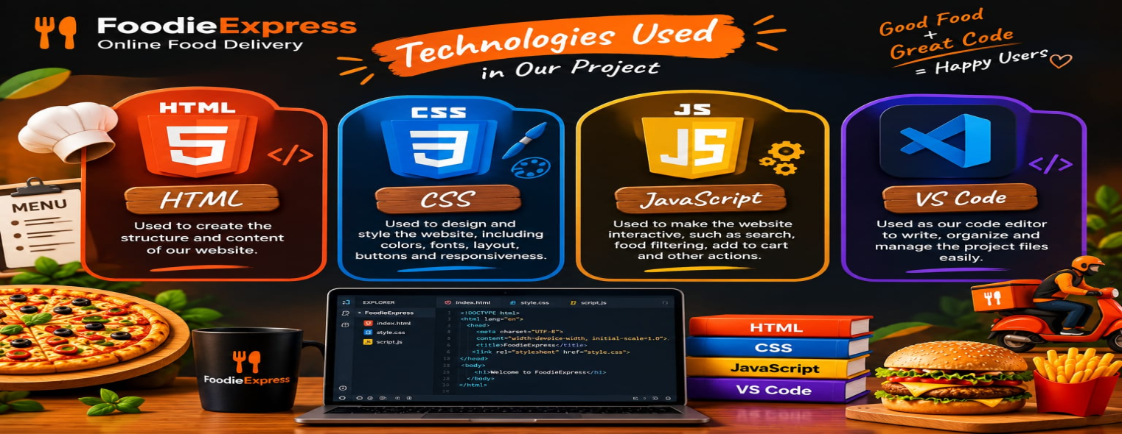
TECHNICAL DETAILS
HTML:- Use to create website pages, forms, buttons and structure.
CSS:- Use for colors , layout , cards, buttons and responsive designs.
Java Script:- Use for cart , search , quantity , checkout and other actions.
Tools:- VS code and Web browser are used.

Slide 8
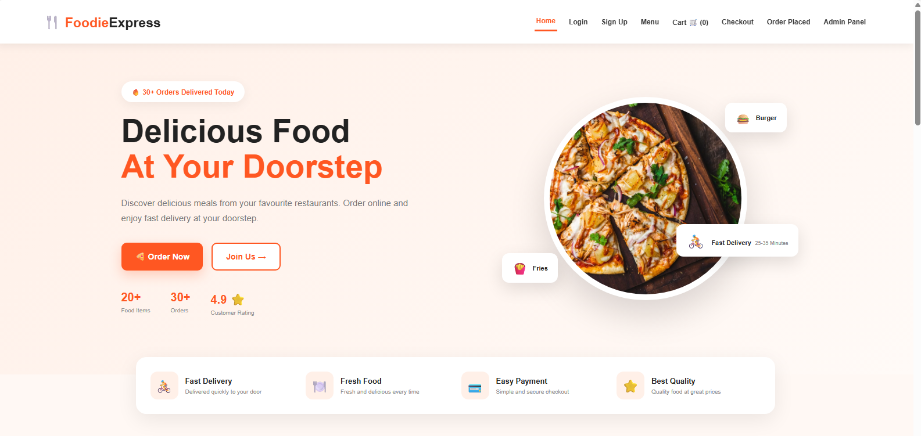
HOME :-
Welcome page of food delivery.
Show food image and many items.
Provides navigation to the other pages.

Slide 9
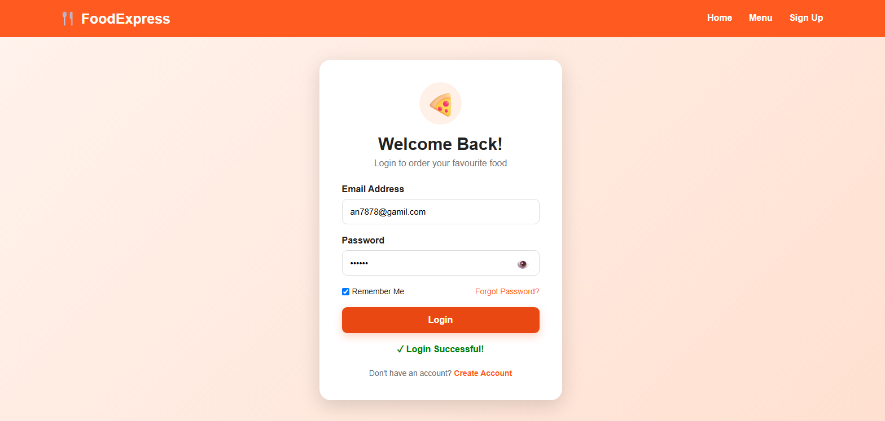
LOGIN:-
Allows an existing user to login.
Takes basic login information.
Provides a simple login interface.

Slide 10
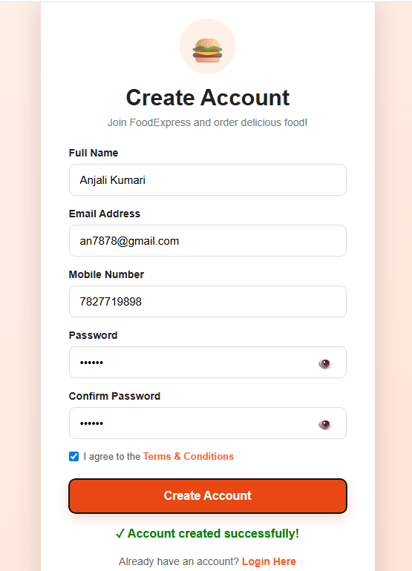

SIGN UP:-
Allows a new user to create and account.
Collects basic user details.
Helps user continue to the ordering process.

Slide 11
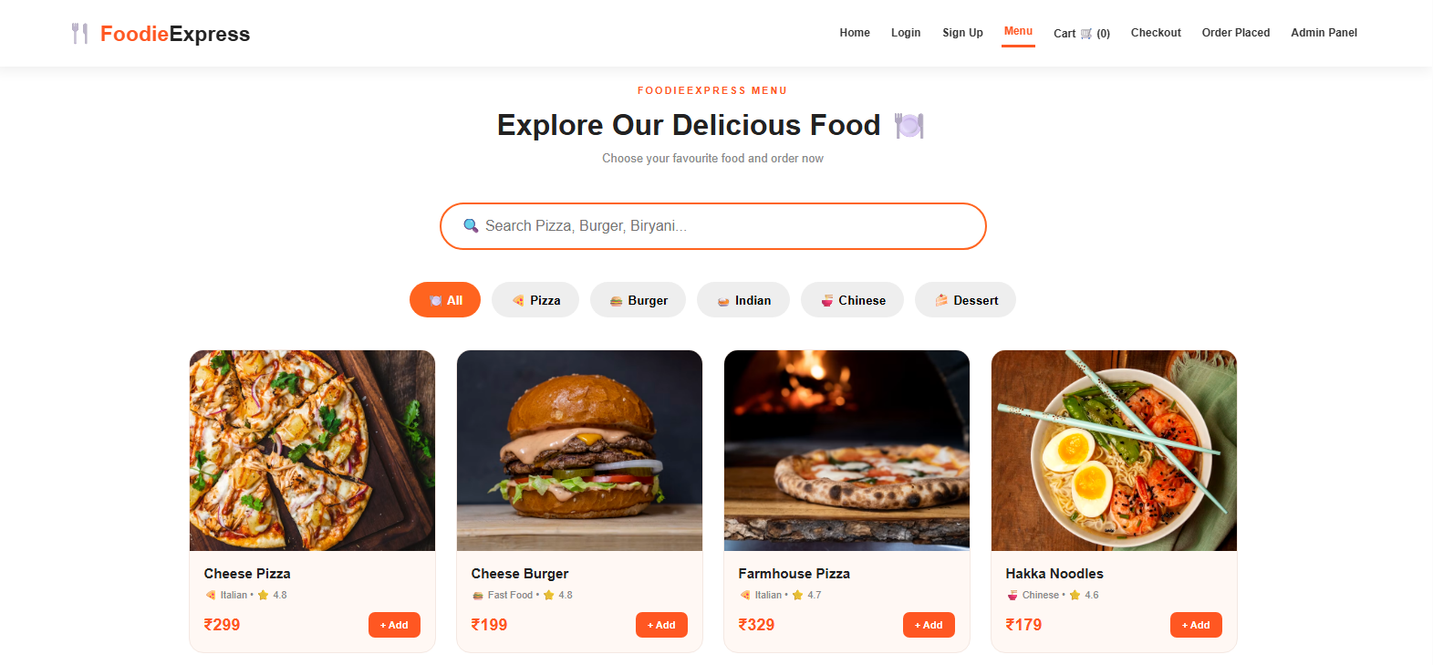
MENU:-
Displays food items ,images , prices and categories.
Search and category filters help users find food.
Add to cart use to select food.

Slide 12
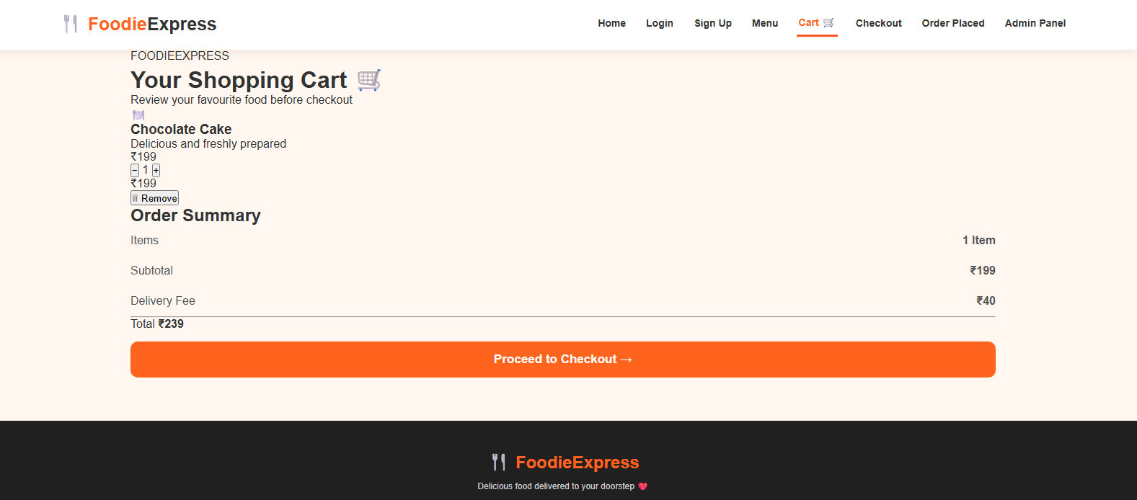
CART:-
Shows Selected food items.
User can change quantity all remove items.
Subtotal , delivery free and total are calculated.

Slide 13
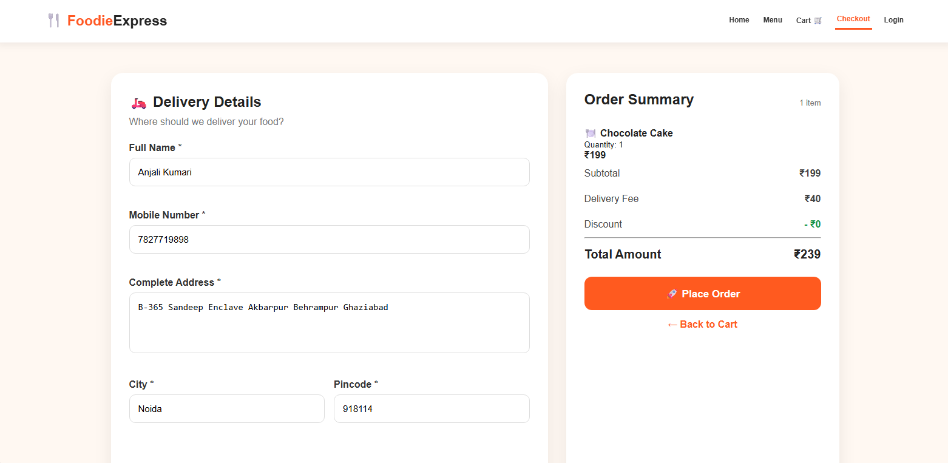
CHECK OUT:-
Shows the final order summary.
Collects customer and delivery details.
Place order continues to order conformation.

Slide 14
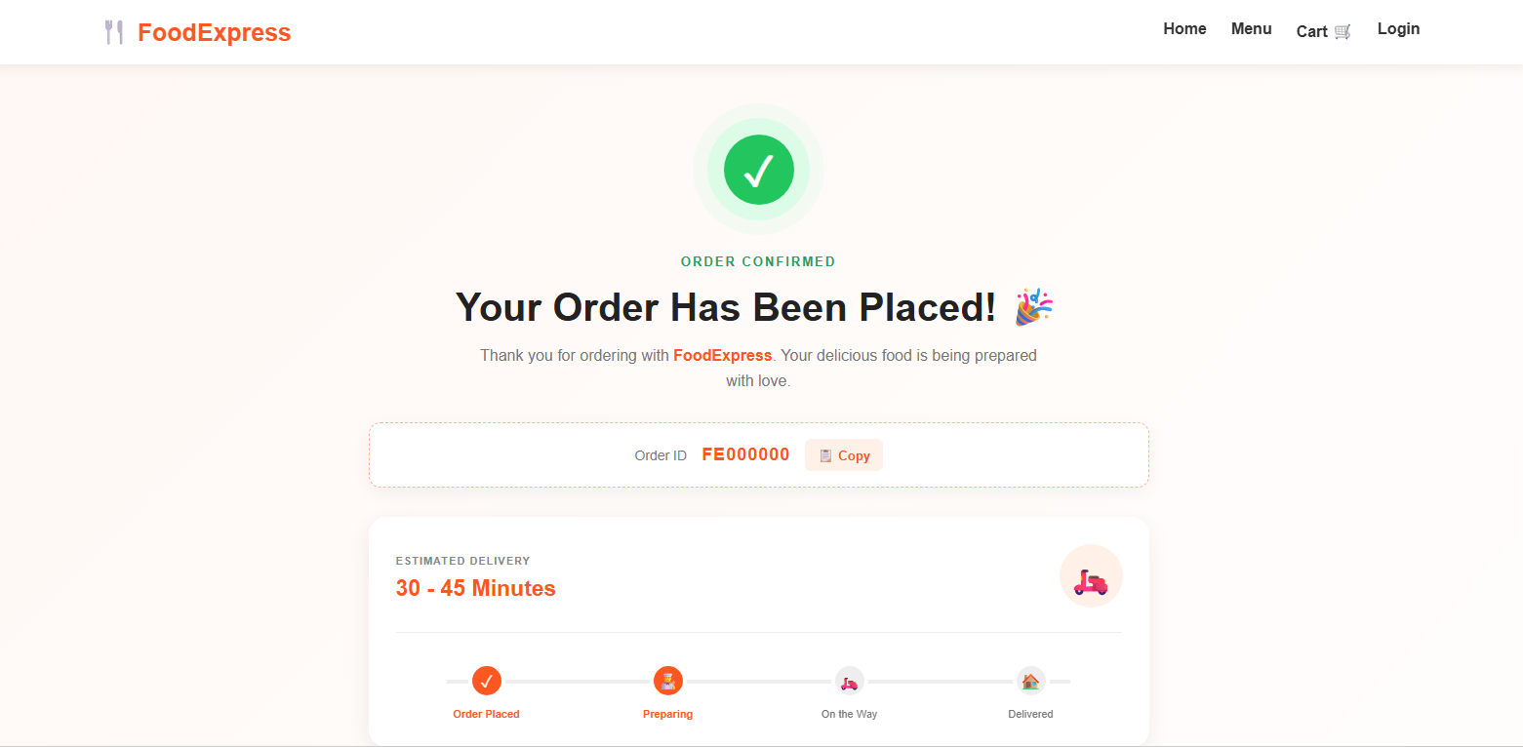
ORDER PLACED:-
Confirms that the order has been placed.
Shows order information.
Provides the next step for viewing the order.

Slide 15
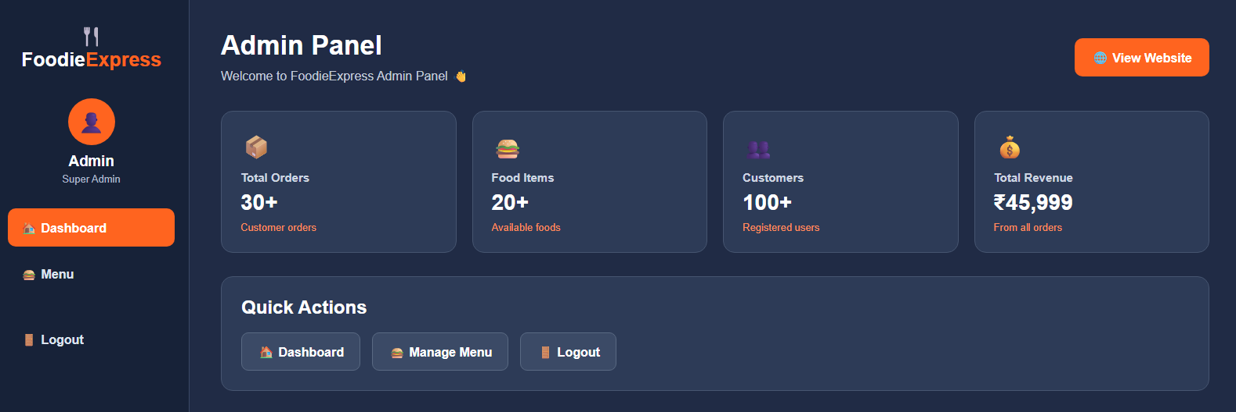
ADMIN PANEL:-
Provides the admin dashboard .
Admin can open Dashboard, Menu and logout.

Slide 16


PROJECT TEAM:-
ANJALI KUMARI KOMAL

Slide 17

THANK YOU!

